Slide 1
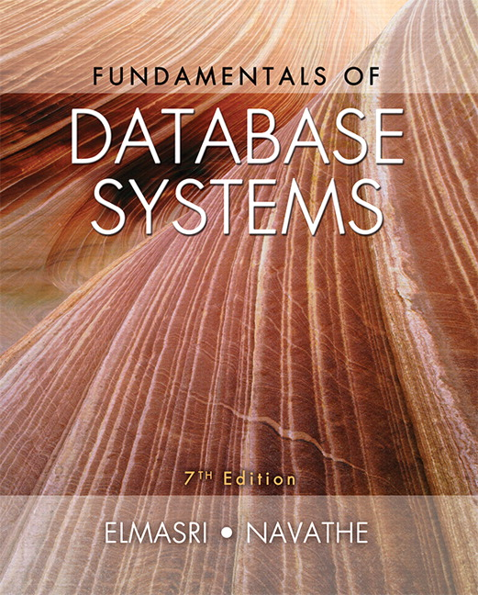
Principle of Database Systems
Instructor:
Dr. AHMED AWAIS

Slide 2
Your Instructor Introduction

Slide 3
Rules for class
Everyone is responsible for maintaining class discipline.
The use of mobile phones 📱 is strictly prohibited. If you have an urgent matter, please leave the classroom to handle it.
Arriving more than 15 minutes late will be marked as an absence for that session.
Cheating during tests is strictly prohibited. If caught, you will receive a score of zero (0) for that test. Cross-group discussions are not allowed during group-based tests.

Slide 4
Course Outline
Let’s discuss it !

Slide 5
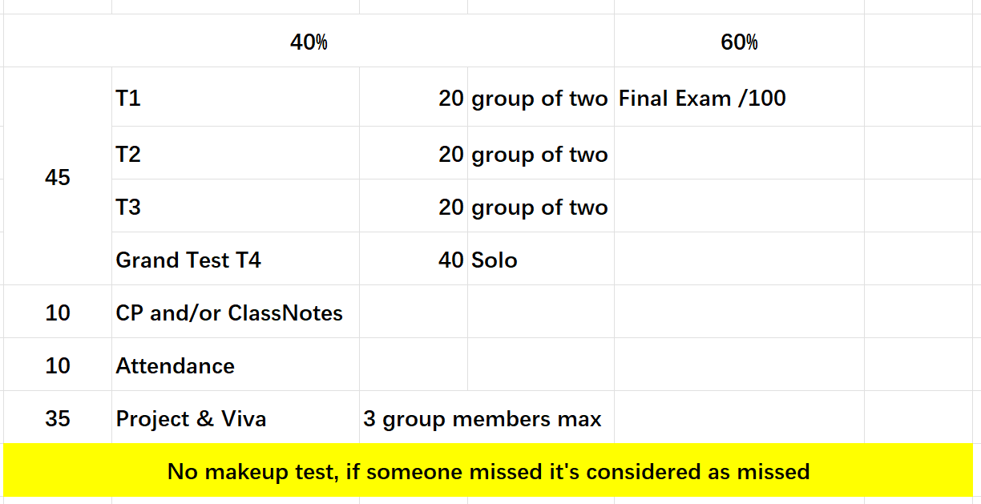
Course Evaluation

Slide 6
Ch#1 Databases and Database Users

Slide 7
What is a Data and database?
Data: Storable variable such as name, age, gender etc.
Database: A collection of related data
Traditional Database Applications (for beginners)
Examples include relational databases like MySQL, Oracle, and PostgreSQL
New Types of Database Systems
Big Data Storage Systems
NoSQL Systems
Examples include MongoDB, Cassandra, and Hadoop

Slide 8
Purpose of a Database
The purpose of a database is to keep track of things.
Unlike a list or spreadsheet, a database may store information that is more complicated than a simple list.

Slide 9
What is a Database System?
A database system is comprised of four components:
Users
Database Application
Database Management System (D B M S)
Database

Slide 10
Users Are Dependent on Databases
What do you think? Are users dependent on DB?

Slide 11
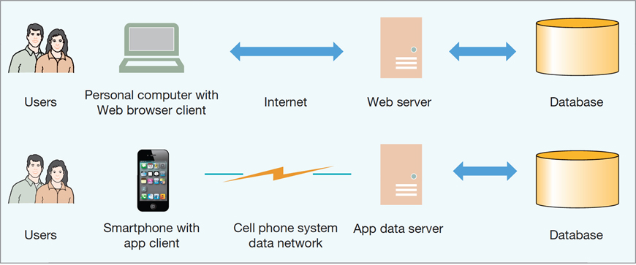
Users Are Dependent on Databases
The Internet and Mobile Device World

Slide 12
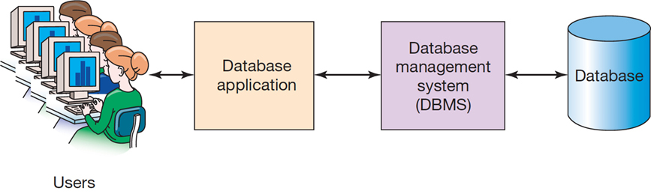
Components of a Database System

Slide 13
Users
A user of a database system will:
Use a database application to track things
Use forms to enter, read, delete, and query data
Produce reports

Slide 14
The Database
A database is a self-describing collection of related tables.
The database itself contains the definition of its structure.
Metadata is data describing the structure of the database data.
Tables within a relational database are related to each other.

Slide 15
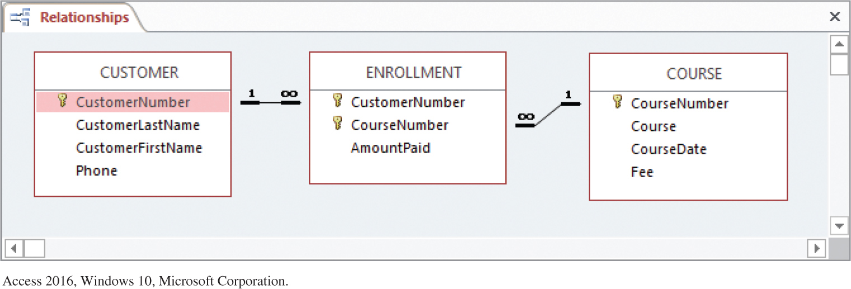
Example Database Metadata: A Relational Diagram
Example Metadata: A Relationship Diagram for the Art Course Tables

Slide 16
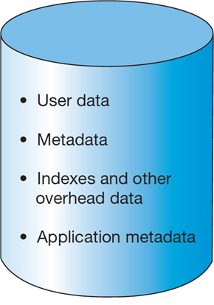
Database Contents
Slide 1- 16

Slide 17
Database Management System (D B M S)
A database management system (D B M S) serves as an intermediary between database applications and the database.
The D B M S manages and controls database activities.
The D B M S creates, processes, and administers the databases it controls.
MySQL (Relational DBMS), PostgreSQL (Object-relational DBMS), Oracle (Relational DBMS) etc

Slide 18
Example DBMS
DBMS | Type | Use Case | Example Industry | Example Query (Key Feature)
MySQL | Relational DBMS | Web applications, small to medium systems | Startups, small-scale projects | CREATE DATABASE, INSERT INTO
PostgreSQL | Object-Relational DBMS | Complex queries, scalable systems | Finance, scientific research | SERIAL PRIMARY KEY
Oracle | Relational DBMS | Large enterprise applications, complex transactions | Enterprises, government | NUMBER PRIMARY KEY, VARCHAR2
MongoDB | NoSQL, Document-based DBMS | Unstructured data, flexible schemas | Real-time analytics, CMS | Document-based storage (JSON)
SQL Server | Relational DBMS | Corporate environments, BI tools | Large organizations, BI | NVARCHAR, DECIMAL

Slide 19
Functions of a D B M S
Create database
Create tables
Create supporting structures (e.g., indexes)
Read database data
Modify (insert, update, or delete) database data
Maintain database structures
Enforce rules
Control concurrency
Provide security
Perform backup and recovery

Slide 20
Impact of Databases and Database Technology
Businesses: Banking, Insurance, Retail, Transportation, Healthcare, Manufacturing
Service Industries: Financial, Real-estate, Legal, Electronic Commerce, Small businesses
Education : Resources for content and Delivery
More recently: Social Networks, Environmental and Scientific Applications, Medicine and Genetics
Personalized Applications: based on smart mobile devices

Slide 21
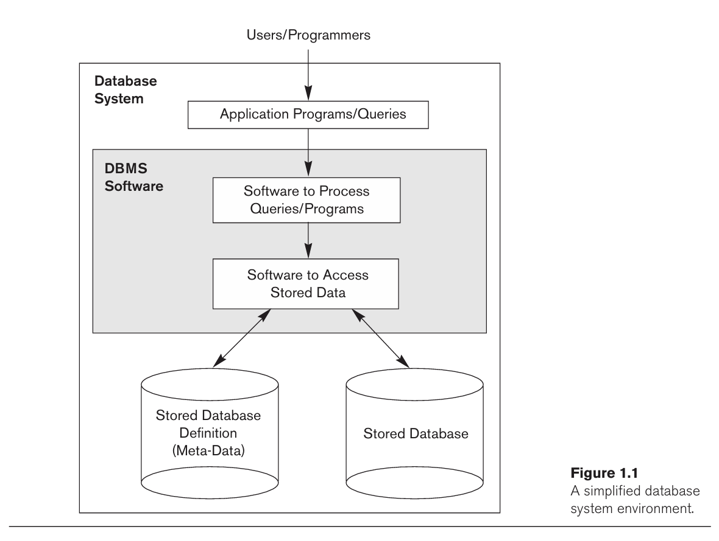
Simplified database system environment

Slide 22
Typical DBMS Functionality
Define a particular database in terms of its data types, structures, and constraints
Construct or Load the initial database contents on a secondary storage medium
Manipulating the database:
Retrieval: Querying, generating reports
Modification: Insertions, deletions and updates to its content
Accessing the database through Web applications
Processing and Sharing by a set of concurrent users and application programs – yet, keeping all data valid and consistent

Slide 23
Application Activities Against a Database
Applications interact with a database by generating
- Queries: that access different parts of data and formulate the result of a request
- Transactions: that may read some data and “update” certain values or generate new data and store that in the database
Applications must not allow unauthorized users to access data
Applications must keep up with changing user requirements against the database

Slide 24
Additional DBMS Functionality
DBMS may additionally provide:
Protection or Security measures to prevent unauthorized access
“Active” processing to take internal actions on data
Presentation and Visualization of data
Maintenance of the database and associated programs over the lifetime of the database application
Called database, software, and system maintenance

Slide 25
Example of a Database (with a Conceptual Data Model)
Mini-world for the example:
Part of a UNIVERSITY environment.
Some mini-world entities:
STUDENTs
COURSEs
SECTIONs (of COURSEs)
(academic) DEPARTMENTs
INSTRUCTORs

Slide 26
Example of a Database (with a Conceptual Data Model)
Some mini-world relationships:
SECTIONs are of specific COURSEs
STUDENTs take SECTIONs
COURSEs have prerequisite COURSEs
INSTRUCTORs teach SECTIONs
COURSEs are offered by DEPARTMENTs
STUDENTs major in DEPARTMENTs
Note: The above entities and relationships are typically expressed in a conceptual data model, such as the ENTITY-RELATIONSHIP data model (see Chapters 3, 4)

Slide 27
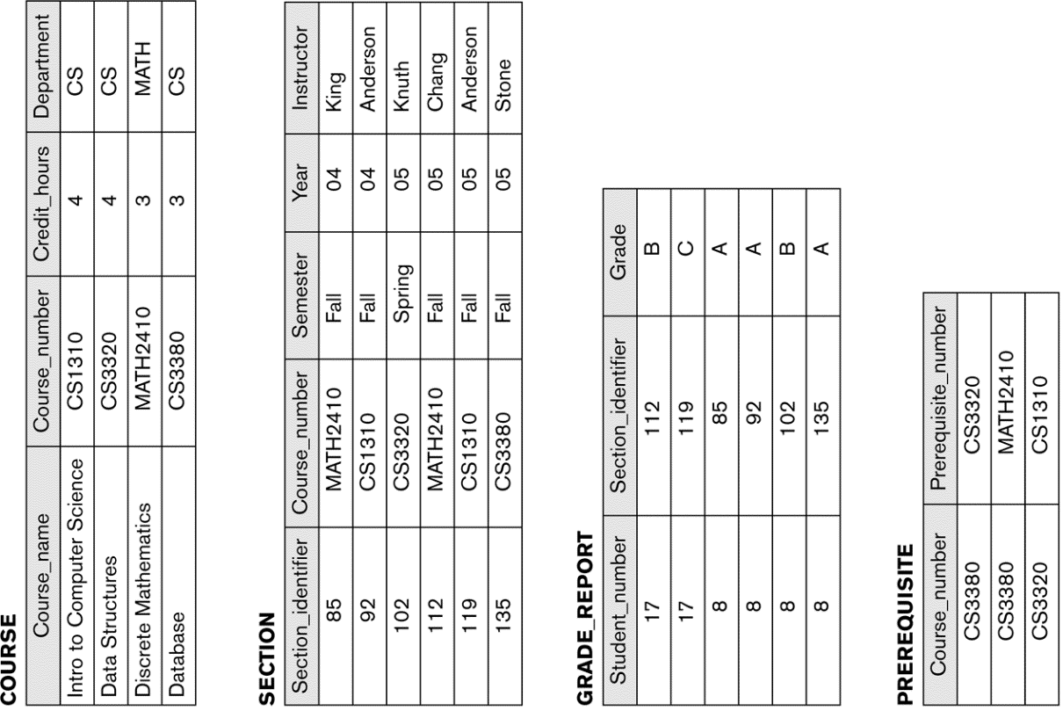
Example of a simple database

Slide 28
Main Characteristics of the Database Approach
Self-describing nature of a database system:
A DBMS catalog stores the description of a particular database (e.g. data structures, types, and constraints)
The description is called meta-data*.
This allows the DBMS software to work with different database applications.

Slide 29
Main Characteristics of the Database Approach
Insulation between programs and data:
Called program-data independence.
Allows changing data structures and storage organization without having to change the DBMS access programs.
-----------------------------------------------------------------------------
* Some newer systems such as a few NOSQL systems need no meta-data: they store the data definition within its structure making it self describing

Slide 30
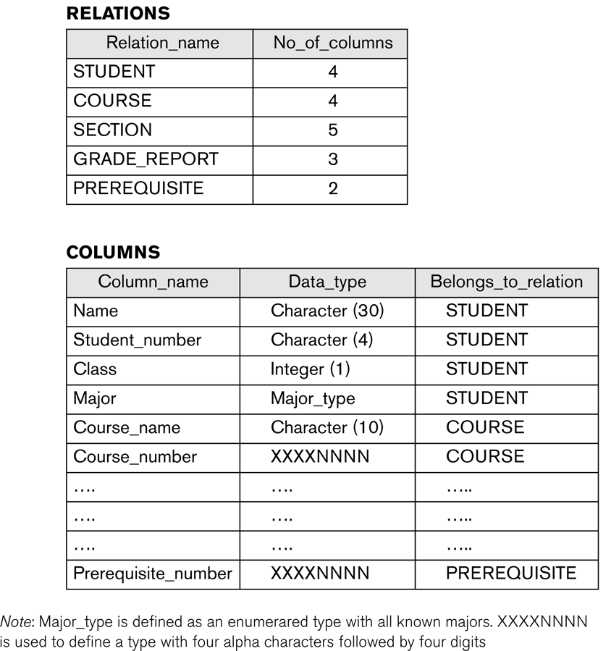
Example of a simplified database catalog

Slide 31
Main Characteristics of the Database Approach (continued)
Data Abstraction:
A data model is used to hide storage details and present the users with a conceptual view of the database.
Programs refer to the data model constructs rather than data storage details
Support of multiple views of the data:
Each user may see a different view of the database, which describes only the data of interest to that user.

Slide 32
Main Characteristics of the Database Approach (continued)
Sharing of data and multi-user transaction processing:
Allowing a set of concurrent users to retrieve from and to update the database.
Concurrency control within the DBMS guarantees that each transaction is correctly executed or aborted
Recovery subsystem ensures each completed transaction has its effect permanently recorded in the database
OLTP (Online Transaction Processing) is a major part of database applications. This allows hundreds of concurrent transactions to execute per second.

Slide 33
Database Users
Users may be divided into
Those who actually use and control the database content, and those who design, develop and maintain database applications (called “Actors on the Scene”), and
Those who design and develop the DBMS software and related tools, and the computer systems operators (called “Workers Behind the Scene”).

Slide 34
Database Users – Actors on the Scene
Actors on the scene
Database administrators:
Responsible for authorizing access to the database, for coordinating and monitoring its use, acquiring software and hardware resources, controlling its use and monitoring efficiency of operations.
Database Designers:
Responsible to define the content, the structure, the constraints, and functions or transactions against the database. They must communicate with the end-users and understand their needs.

Slide 35
Database End Users
Actors on the scene (continued)
End-users: They use the data for queries, reports and some of them update the database content. End-users can be categorized into:
Casual: access database occasionally when needed
Naïve or Parametric: they make up a large section of the end-user population.
They use previously well-defined functions in the form of “canned transactions” against the database.
Users of Mobile Apps mostly fall in this category
Bank-tellers or reservation clerks are parametric users who do this activity for an entire shift of operations.
Social Media Users post and read information from websites

Slide 36
Database End Users (continued)
Sophisticated:
These include business analysts, scientists, engineers, others thoroughly familiar with the system capabilities.
Many use tools in the form of software packages that work closely with the stored database.
Stand-alone:
Mostly maintain personal databases using ready-to-use packaged applications.
An example is the user of a tax program that creates its own internal database.
Another example is a user that maintains a database of personal photos and videos.

Slide 37
Database Users – Actors on the Scene (continued)
System Analysts and Application Developers
This category currently accounts for a very large proportion of the IT work force.
System Analysts: They understand the user requirements of naïve and sophisticated users and design applications including canned transactions to meet those requirements.
Application Programmers: Implement the specifications developed by analysts and test and debug them before deployment.
Business Analysts: There is an increasing need for such people who can analyze vast amounts of business data and real-time data (“Big Data”) for better decision making related to planning, advertising, marketing etc.

Slide 38
Database Users – Workers behind the Scene
System Designers and Implementors: Design and implement DBMS packages in the form of modules and interfaces and test and debug them. The DBMS must interface with applications, language compilers, operating system components, etc.
Tool Developers: Design and implement software systems called tools for modeling and designing databases, performance monitoring, prototyping, test data generation, user interface creation, simulation etc. that facilitate building of applications and allow using database effectively.
Operators and Maintenance Personnel: They manage the actual running and maintenance of the database system hardware and software environment.

Slide 39
Advantages of Using the Database Approach
Controlling redundancy in data storage and in development and maintenance efforts.
Sharing of data among multiple users.
Restricting unauthorized access to data. Only the DBA staff uses privileged commands and facilities.
Providing persistent storage for program Objects
E.g., Object-oriented DBMSs make program objects persistent– see Chapter 12.
Providing Storage Structures (e.g. indexes) for efficient Query Processing – see Chapter 17.

Slide 40
Advantages of Using the Database Approach (continued)
Providing optimization of queries for efficient processing.
Providing backup and recovery services.
Providing multiple interfaces to different classes of users.
Representing complex relationships among data.
Enforcing integrity constraints on the database.
Drawing inferences and actions from the stored data using deductive and active rules and triggers.

Slide 41
Additional Implications of Using the Database Approach
Potential for enforcing standards:
This is very crucial for the success of database applications in large organizations. Standards refer to data item names, display formats, screens, report structures, meta-data (description of data), Web page layouts, etc.
Reduced application development time:
Incremental time to add each new application is reduced.

Slide 42
Additional Implications of Using the Database Approach (continued)
Flexibility to change data structures:
Database structure may evolve as new requirements are defined.
Availability of current information:
Extremely important for on-line transaction systems such as shopping, airline, hotel, car reservations.
Economies of scale:
Wasteful overlap of resources and personnel can be avoided by consolidating data and applications across departments.

Slide 43
Historical Development of Database Technology
Early Database Applications:
The Hierarchical and Network Models were introduced in mid 1960s and dominated during the seventies.
A bulk of the worldwide database processing still occurs using these models, particularly, the hierarchical model using IBM’s IMS system.
Relational Model based Systems:
Relational model was originally introduced in 1970, was heavily researched and experimented within IBM Research and several universities.
Relational DBMS Products emerged in the early 1980s.

Slide 44
Historical Development of Database Technology (continued)
Object-oriented and emerging applications:
Object-Oriented Database Management Systems (OODBMSs) were introduced in late 1980s and early 1990s to cater to the need of complex data processing in CAD (Computer-Aided Design) and other applications.
Their use has not taken off much.
Many relational DBMSs have incorporated object database concepts, leading to a new category called object-relational DBMSs (ORDBMSs)
Extended relational systems add further capabilities (e.g. for multimedia data, text, XML, and other data types)

Slide 45
Historical Development of Database Technology (continued)
Data on the Web and E-commerce Applications:
Web contains data in HTML (Hypertext markup language) with links among pages.
This has given rise to a new set of applications and E-commerce is using new standards like XML (eXtended Markup Language). (see Ch. 13).
Script programming languages such as PHP and JavaScript allow generation of dynamic Web pages that are partially generated from a database (see Ch. 11).
Also allow database updates through Web pages

Slide 46
Extending Database Capabilities (1)
New functionality is being added to DBMSs in the following areas:
Scientific Applications – Physics, Chemistry, Biology - Genetics
Earth and Atmospheric Sciences and Astronomy
XML (eXtensible Markup Language)
Image Storage and Management
Audio and Video Data Management
Data Warehousing and Data Mining – a very major area for future development using new technologies (see Chapters 28-29)
Spatial Data Management and Location Based Services
Time Series and Historical Data Management
The above gives rise to new research and development in incorporating new data types, complex data structures, new operations and storage and indexing schemes in database systems.

Slide 47
Extending Database Capabilities (2)
Background since the advent of the 21st Century:
First decade of the 21st century has seen tremendous growth in user generated data and automatically collected data from applications and search engines.
Social Media platforms such as Facebook and Twitter are generating millions of transactions a day and businesses are interested to tap into this data to “understand” the users
Cloud Storage and Backup is making unlimited amount of storage available to users and applications

Slide 48
Extending Database Capabilities (3)
Emergence of Big Data Technologies and NOSQL databases
New data storage, management and analysis technology was necessary to deal with the onslaught of data in petabytes a day (10**15 bytes or 1000 terabytes) in some applications – this started being commonly called as “Big Data”.
Hadoop (which originated from Yahoo) and Mapreduce Programming approach to distributed data processing (which originated from Google) as well as the Google file system have given rise to Big Data technologies (Chapter 25). Further enhancements are taking place in the form of Spark based technology.

Slide 49
Extending Database Capabilities (4)
Emergence of Big Data Technologies and NOSQL databases
NOSQL (Not Only SQL- where SQL is the de facto standard language for relational DBMSs) systems have been designed for rapid search and retrieval from documents, processing of huge graphs occurring on social networks, and other forms of unstructured data with flexible models of transaction processing (Chapter 24).

Slide 50
Relational Database Tables
A relational database stores data in tables.
Each table holds data about one single theme.
In a relational database, tables are joined together using the value of the data.
Relational databases minimize data redundancy, preserve complex relationships, and allow for partial data.

Slide 51
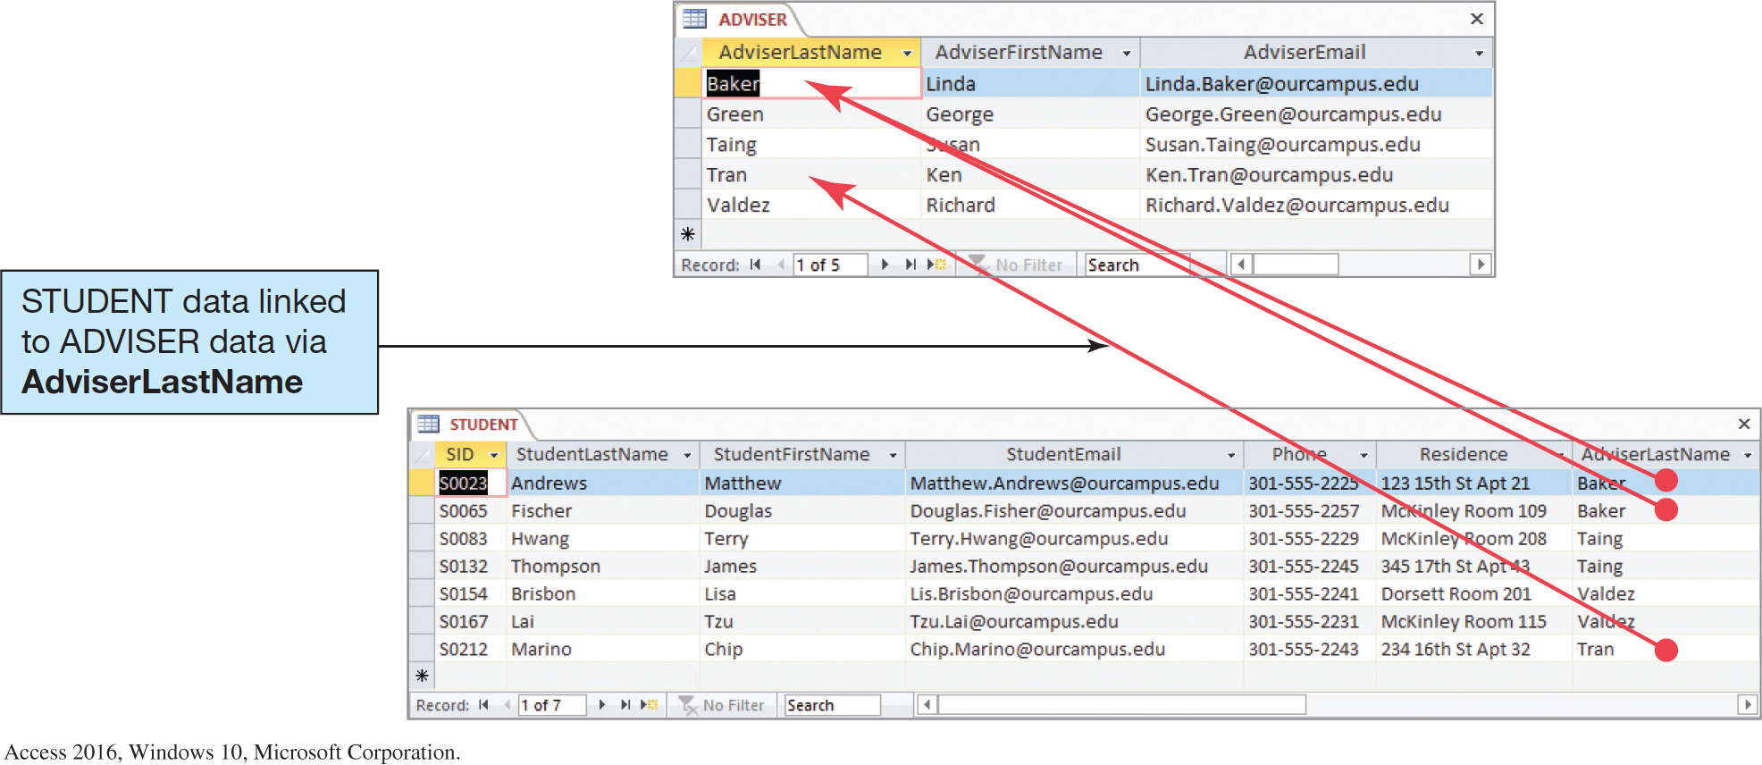
Relational Database Example
The Adviser and Student Tables

Slide 52
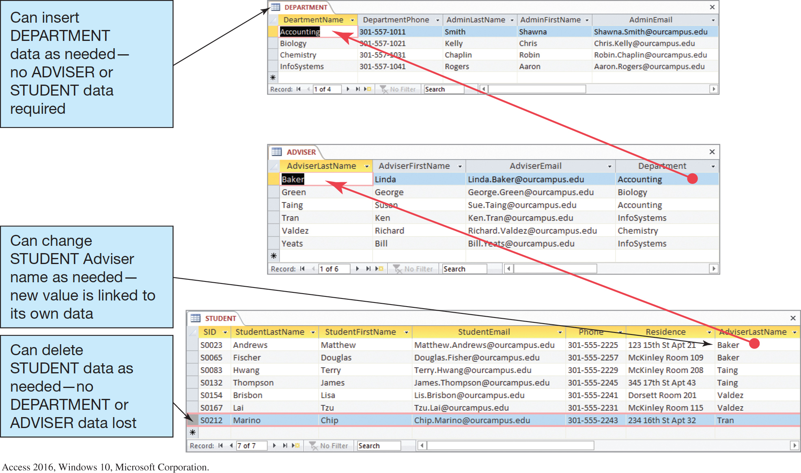
The Department, Adviser, and Student Tables

Slide 53
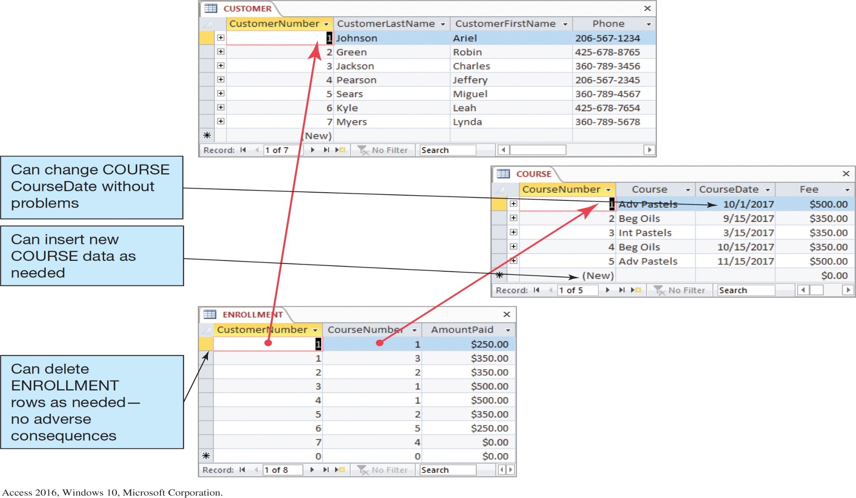
The Art Course Database Tables

Slide 54
Relational Tables are Processed by Structured Query Language (S Q L)
Structured Query Language (S Q L) is an international standard for creating, processing, and querying databases and their tables.
Many databases use S Q L to retrieve, format, report, insert, delete, and/or modify data for users.

Slide 55
S Q L Example (1 of 2)
We can use S Q L to combine the data in the three tables in the Art Course Database to recreate the original list structure of the data that was in the spreadsheet.
We do this by using an S Q L SELECT statement as shown on the next slide.

Slide 56

S Q L Example (2 of 2)
The results of this S Q L code can be seen on the next page.

Slide 57
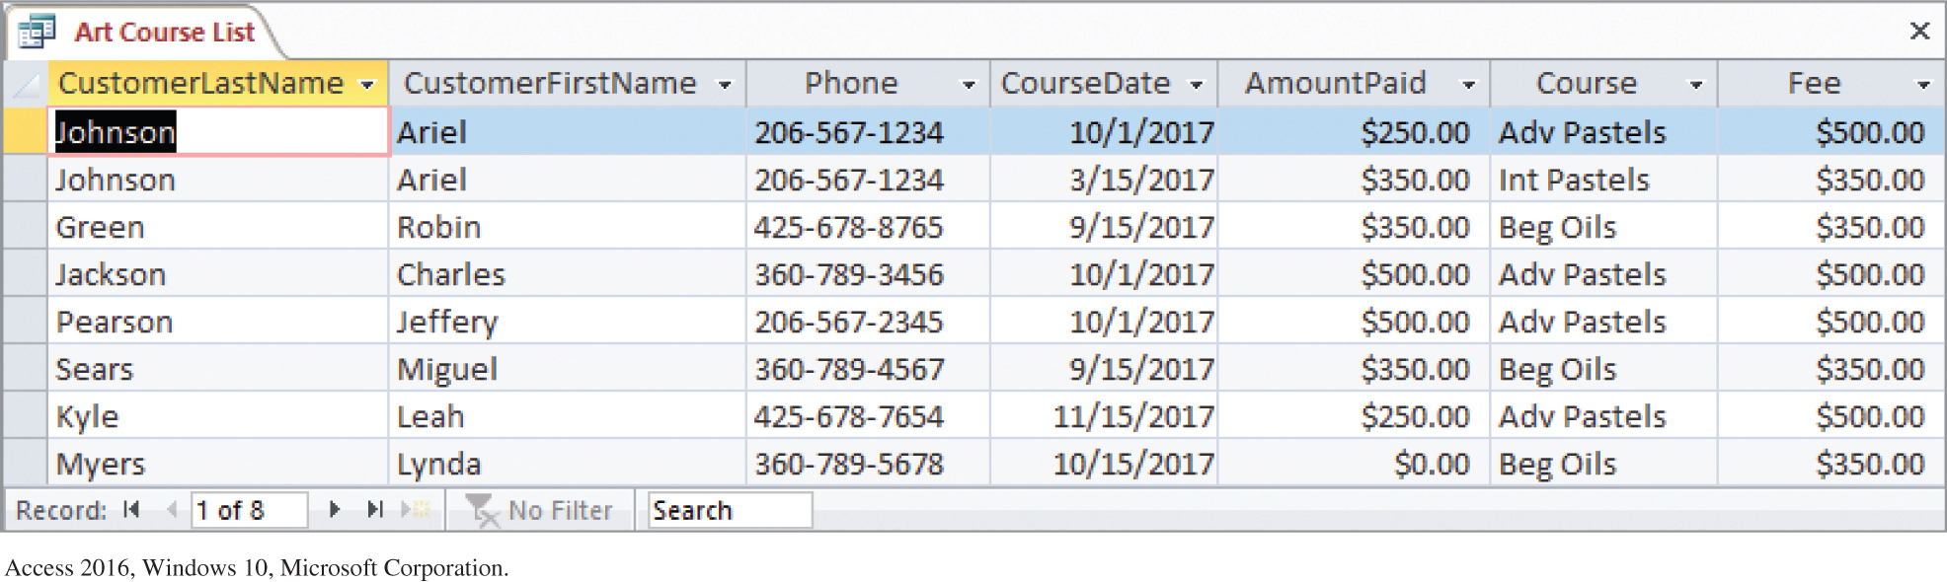
S Q L Example Results for the Art Course Database
Results of the S Q L Query to Recreate the Art Course List Data

Slide 58
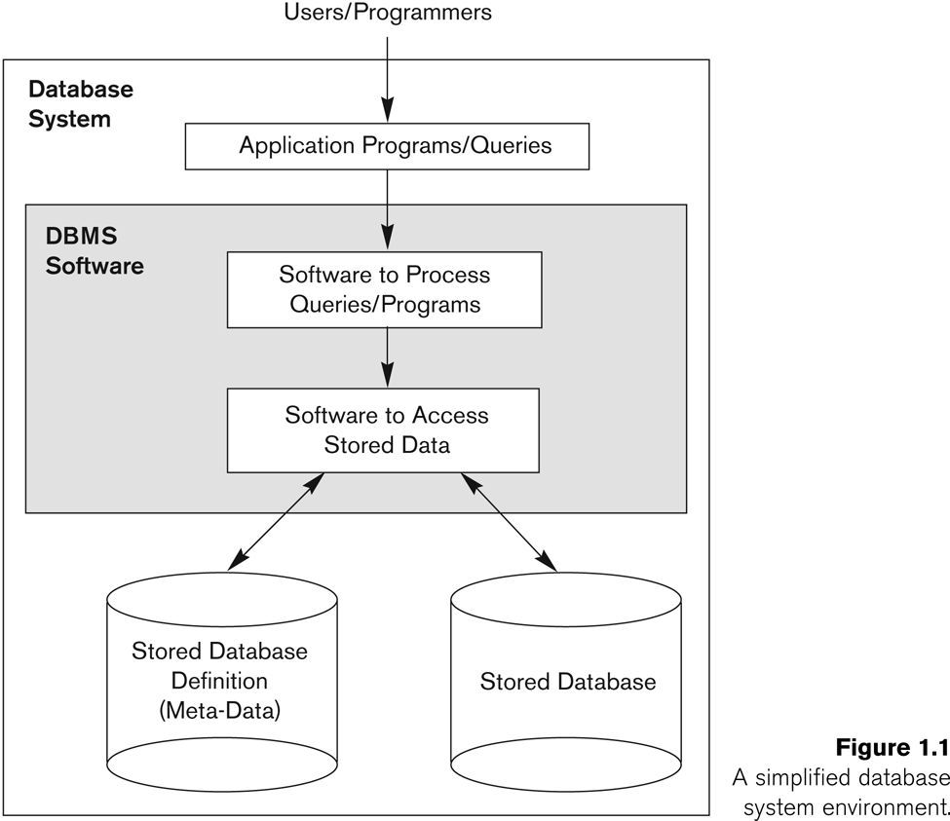
Chapter 1 (Summary)
Database & Database Users
Characteristics of DB Approach
Self-describing
Data Abstraction (insulation between program & Data)
Support of Multiple Views of Data
Sharing of Data and Multiuser transaction processing (OLTP)
Actors on the Scene
Database Administrator
Database Designer
End Users
Software Analysts and Application Programmers
Advantages of DB Approach
Controlling Redundancy
Restricting Unauthorized Access
Providing Persistent Storage for Program Objects
Efficient Storage and Query Processing
Providing Backup & Recovery
Providing Multiple User Interface
Representing Complex Relationships among data
Enforcing Integrity Constraints
Economies of Scale
Database Management System
(DBMS)

Slide 59
When not to use a DBMS
Main inhibitors (costs) of using a DBMS:
High initial investment and possible need for additional hardware.
Overhead for providing generality, security, concurrency control, recovery, and integrity functions.
When a DBMS may be unnecessary:
If the database and applications are simple, well defined, and not expected to change.
If access to data by multiple users is not required.
When a DBMS may be infeasible:
In embedded systems where a general purpose DBMS may not fit in available storage

Slide 60
When not to use a DBMS
When no DBMS may suffice:
If there are stringent real-time requirements that may not be met because of DBMS overhead (e.g., telephone switching systems)
If the database system is not able to handle the complexity of data because of modeling limitations (e.g., in complex genome and protein databases)
If the database users need special operations not supported by the DBMS (e.g., GIS and location based services).

